Slide 1



PAGE 1
PSAT SYSTEM LEVEL DESIGN
EMERGENCY VEHICLE PREEMPTION
https://github.com/NishitNfreak/Emergency_Vehicle_Prioritization

Slide 2


PAGE 2
about us
Nishit Agarwal
Piyush Gupta
Sripad Rao
Ketha Lalitha
BL.EN.U4ECE25125
BL.EN.U4ECE25128
BL.ENU4ECE25136
BL.EN.U4ECE2515

Slide 3



PAGE 3
AIM
Build an Emergency Vehicle Prioritization system that changes signal based on detection data.
IMPLEMENTATION
Using multiple functions and loops in python and flowgorithm software to counter all possibilities.
CONTENT
CONCLUSION
Effectiveness of simulation of signal control logic in collaboration with smart sensors and IoT system.

Slide 4
PAGE 4
AIM
To significantly reduce response time for emergency vehicle by giving them priority at traffic signals
Eliminate Manual Intervention:
Enhance Safety:
The system automates the process of granting priority, removing the need for manual traffic control that could be a source of delay
By clearing a path through intersections, the system reduces the risk of accidents between emergency vehicles and other traffic, and the risk of collisions at the intersection itself.
Reduces Response Time:
Improve Traffic Flow:
The primary goal is to shorten the time it takes for emergency vehicles to reach their destination, which can be critical in life-threatening situations.
The system can be integrated into broader traffic management systems to improve the efficiency of emergency response and optimize overall traffic flow, especially during emergencies.

Slide 5
PAGE 5
IMPLEMENTATION
Developing System
Automated Signal
Identification
We have developed a model of Emergency vehicle preemption(EVP) which use a combination of GPS, sensors, and transmitters to communicate with receivers at intersections.
These receivers capture the signals from emergency vehicles and triggers the traffic light making the signal green in the lane of that emergency vehicle and making all other lanes red.
If the receiver does not detect any emergency vehicle the normal traffic cycle goes on. The receiver will consider the emergency vehicle only if siren is on and distance of the vehicle is less than 100m.

Slide 6
PAGE 6
PROCESS
The system begins by displaying a start message and sets up the four directions (N, S, E, W).
It continuously asks for detected direction input (N, E, S, W, or X to exit).
If input is X, it runs a normal signal cycle for all directions before shutdown.
If an emergency vehicle is detected and the siren is ON or message is confirmed, it:
Prints which direction has the emergency vehicle.
Sets that direction to green and others to red.
Simulates the green light for 60 seconds.
After the emergency clears, it restores normal signal cycles.

Slide 7

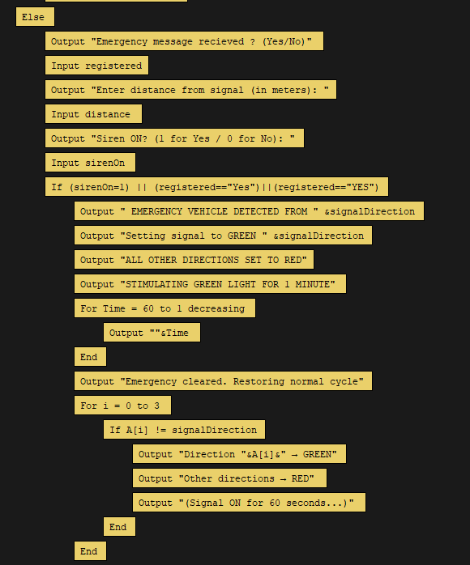
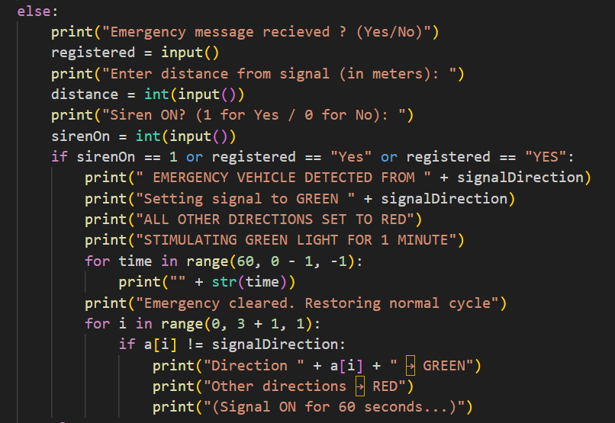
PAGE 7
Flowgorithm Pseudocode
Emergency
CYCLE
Python Code

Slide 8
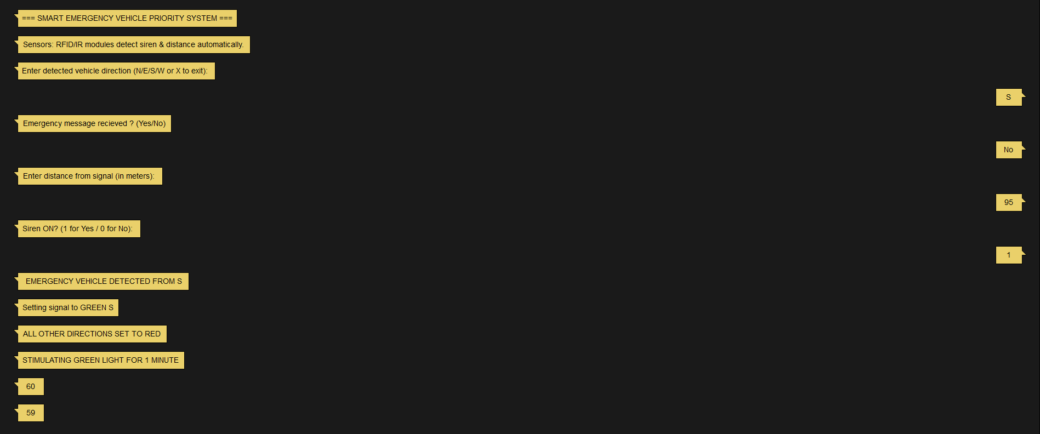
WORKING
PAGE 8

Slide 9
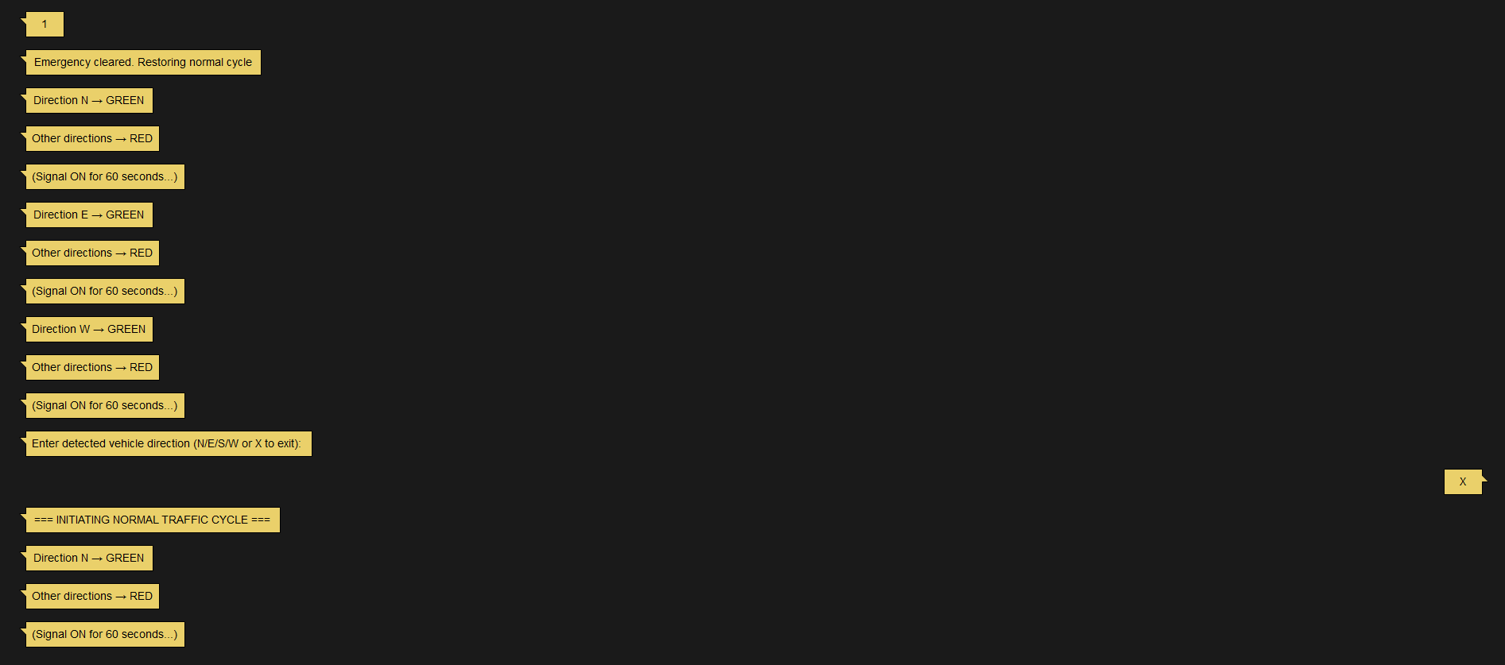
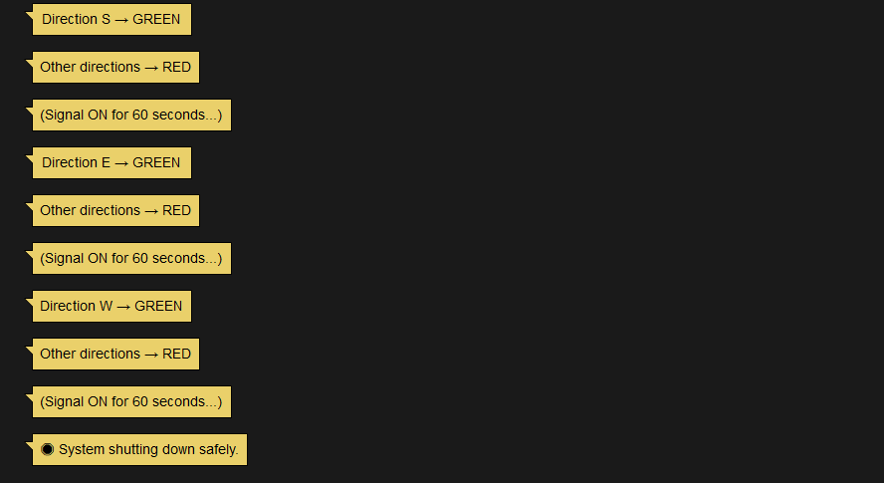
Continuing…
PAGE 9

Slide 10
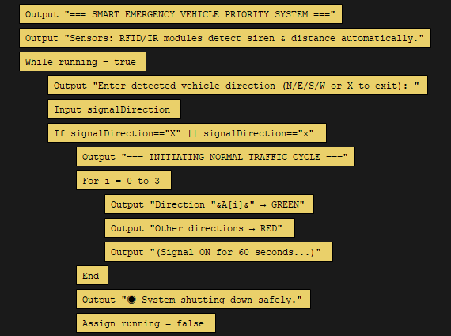
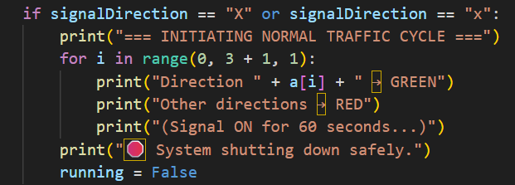
PAGE 10
NORMAL CYCLE
Flowgorithm Pseudocode
Pressing “X” to shut down the system. After completing the Normal Traffic Cycle it shuts down the system
Python Code

Slide 11
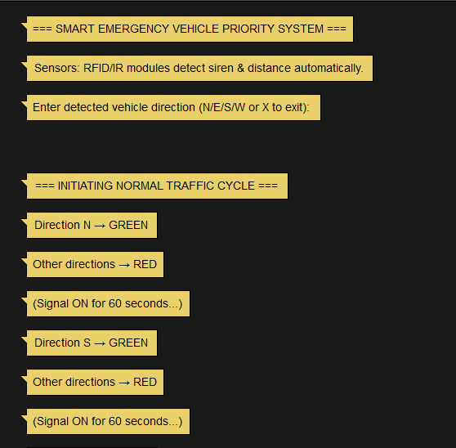
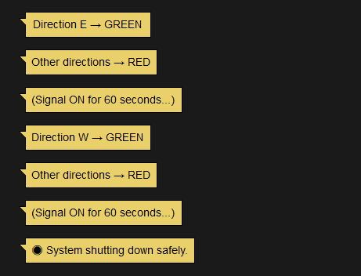
WORKING
PAGE 11

Slide 12
PAGE 12
FUTURE IMPROVEMENTS
Integrate real RFID or IR sensors to automatically detect emergency vehicles.
Add database support (SQLite) to log traffic and preemption data.
Implement computer vision (YOLO) for camera-based detection.
Use multi-intersection communication to form a green corridor for emergency routes.
Use of system which iterates signal timings based on traffic if multiple emergency vehicle is coming from different direction

Slide 13

PAGE 13
OUTCOME
CONCLUSION
Emergency vehicle preemption (EVP) systems significantly reduce emergency response times and improve safety by granting emergency vehicles right-of-way through signalized intersections, but their conclusion must balance these benefits with minimizing disruption to general traffic through optimized routing and intelligent signal management strategies. Future progress will focus on sophisticated algorithms and integrated connectivity for even smoother operations and broader network-wide impact.
Faster and Safe Response
Reduced Accidents
Improved Efficiency

Slide 14
PAGE 14
PSAT SYSTEM LEVEL DESIGN
THANK YOU
https://github.com/NishitNfreak/Emergency_Vehicle_Prioritization

